Slide 1


Slide 2
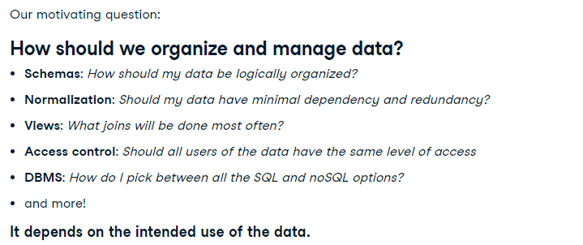

Slide 3


Slide 4

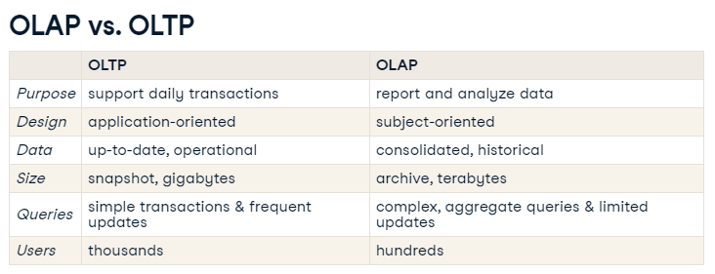

Slide 5
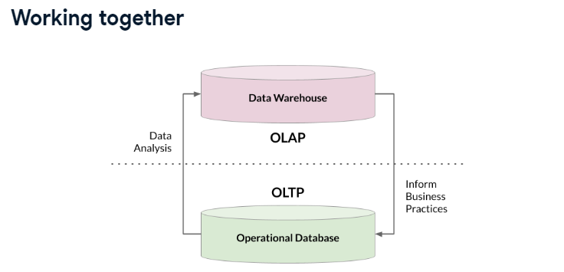

Slide 6
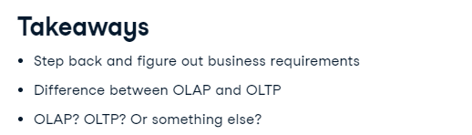

Slide 7


Slide 8
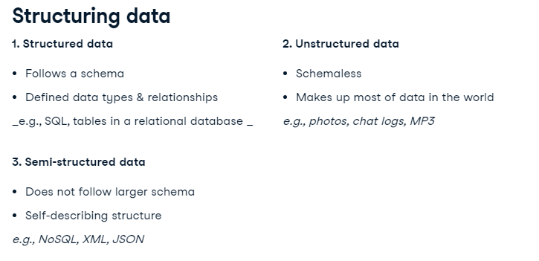
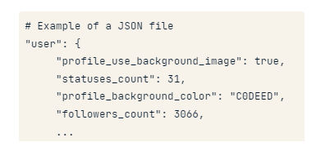

Slide 9
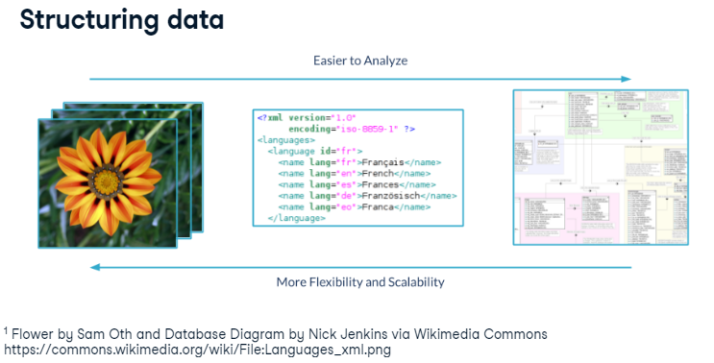

Slide 10
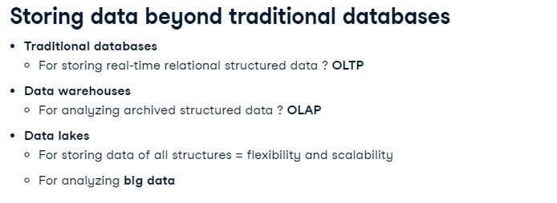

Slide 11
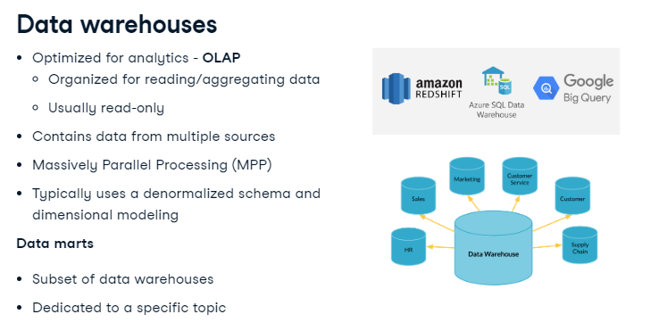

Slide 12
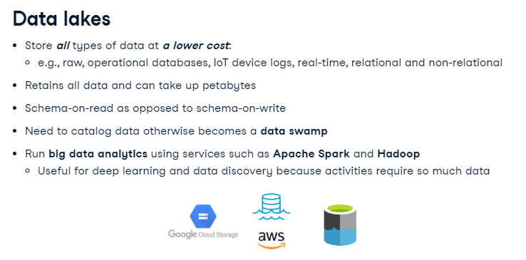

Slide 13
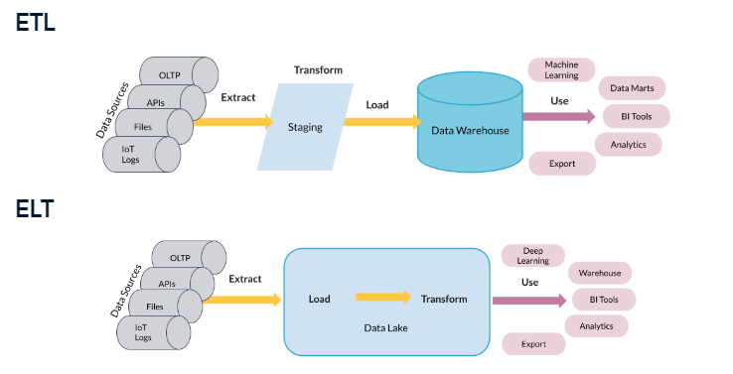

Slide 14
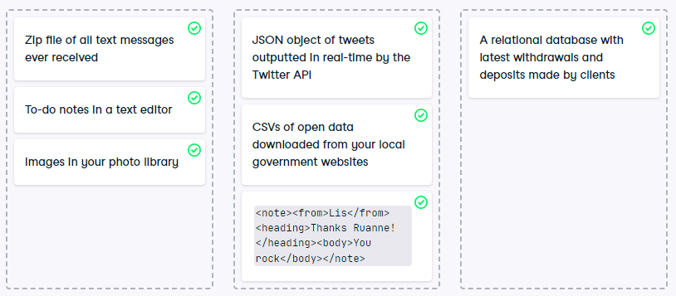

Slide 15


Slide 16
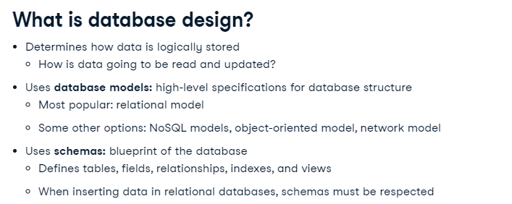

Slide 17
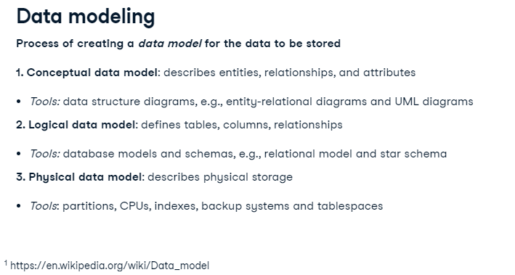

Slide 18
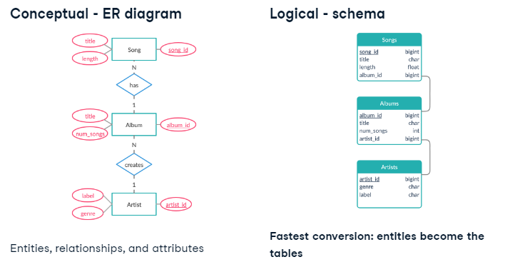

Slide 19
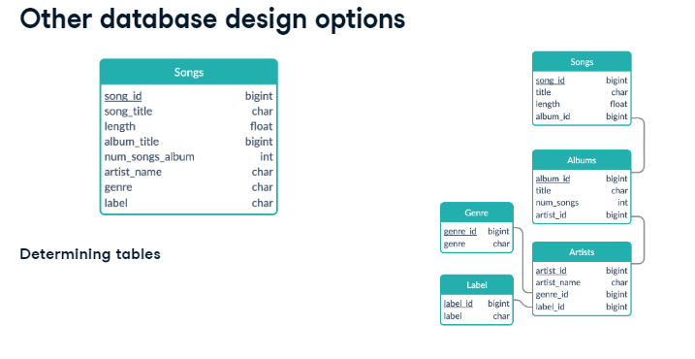

Slide 20
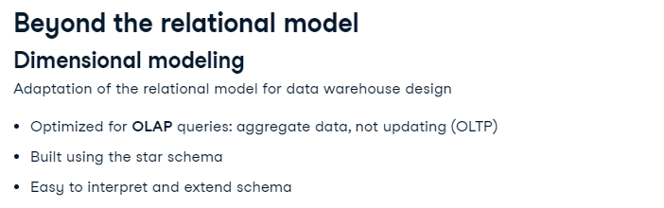

Slide 21
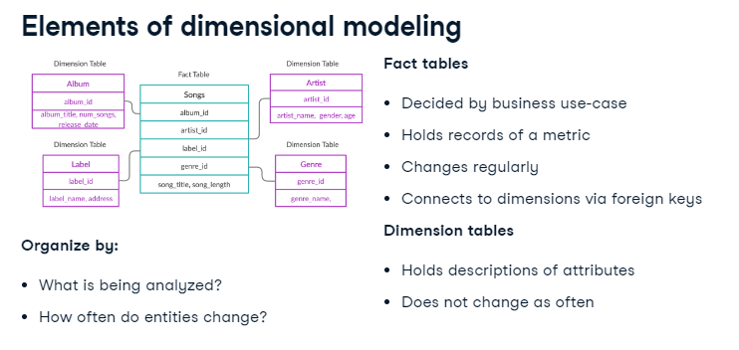

Slide 22
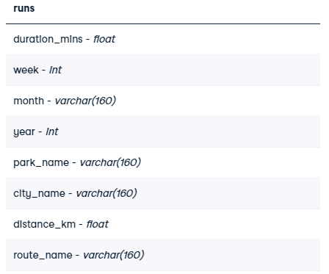

DECIDING FACT AND DIMENSION TABLES:
Imagine that you love running and data. It's only natural that you begin collecting data on your weekly running routine. You're most concerned with tracking how long you are running each week. You also record the route and the distances of your runs. You gather this data and put it into one table called Runs with the following schema:
After learning about dimensional modeling, you decide to restructure the schema for the database. Runs has been pre-loaded for you.

Slide 23
-- Create a route dimension table
CREATE TABLE route(
route_id INTEGER PRIMARY KEY,
park_name VARCHAR(160) NOT NULL,
city_name VARCHAR(160) NOT NULL,
distance_km FLOAT NOT NULL,
route_name VARCHAR(160) NOT NULL
);
-- Create a week dimension table
CREATE TABLE week(
week_id INTEGER PRIMARY KEY,
week INTEGER NOT NULL,
month VARCHAR(160) NOT NULL,
year INTEGER NOT NULL
);

Slide 24
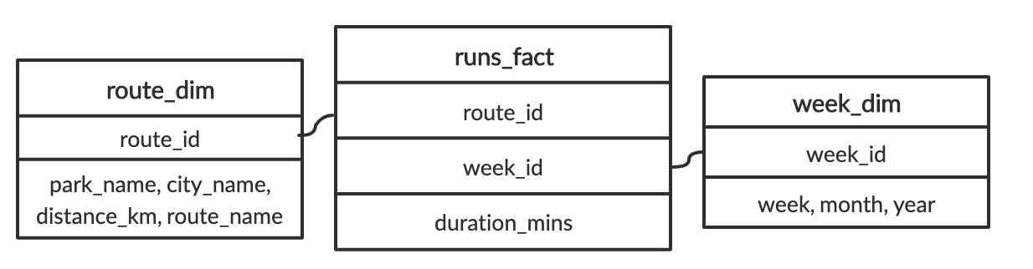
SELECT
-- Get the total duration of all runs
SUM(duration_mins)
FROM
runs_fact
--Get all the week_id's that are from July, 2019
INNER JOIN week_dim ON runs_fact.week_id = week_dim.week_id
WHERE month = 'July' and year = '2019';

Slide 25


Slide 26
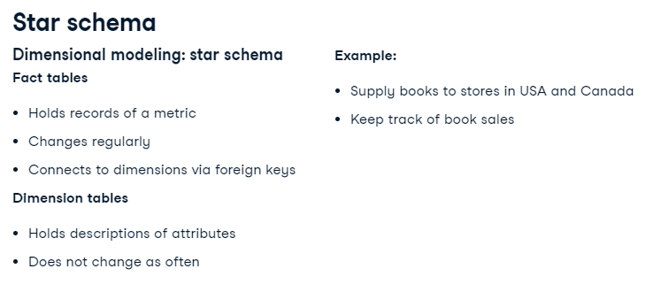

Slide 27
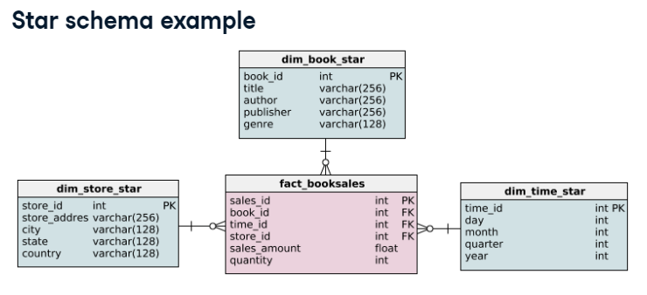

Slide 28
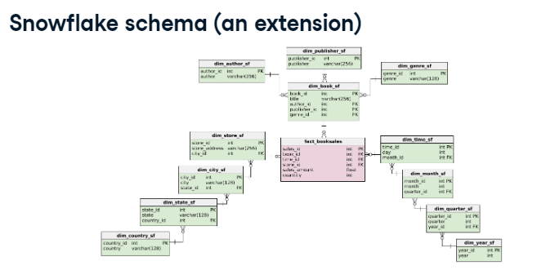

Slide 29
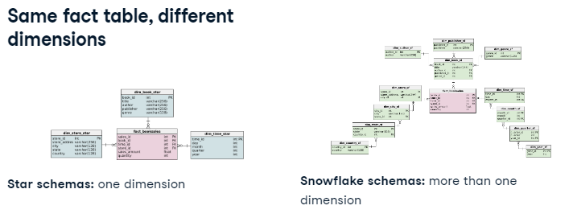

Slide 30
THANK YOU ☺

Slide 31
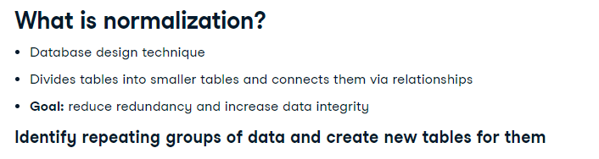

Slide 32
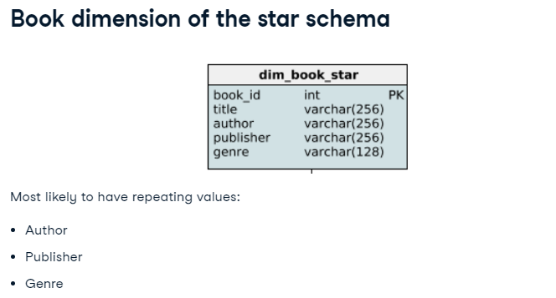

Slide 33
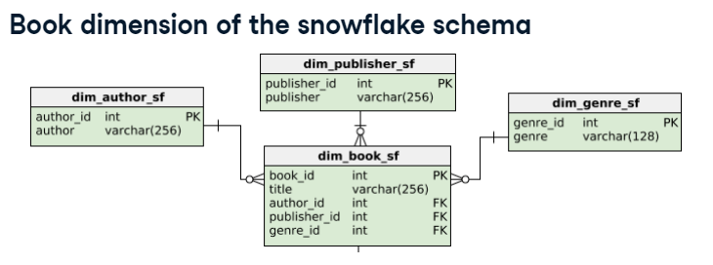

Slide 34
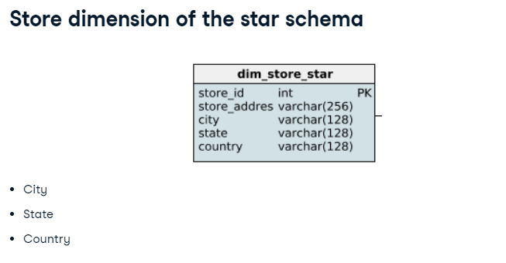

Slide 35
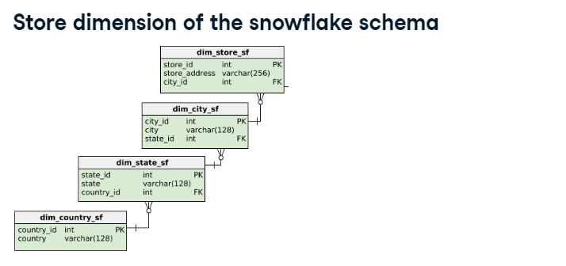
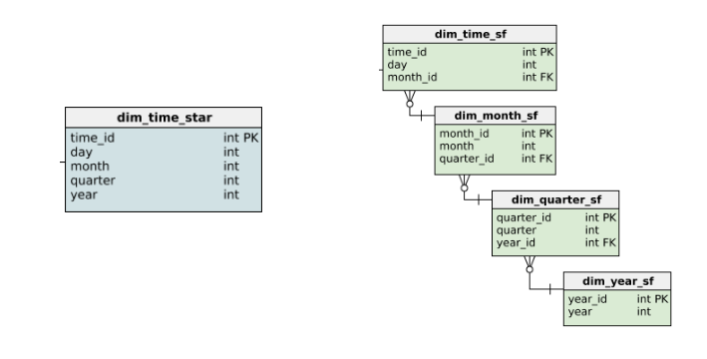

Slide 36
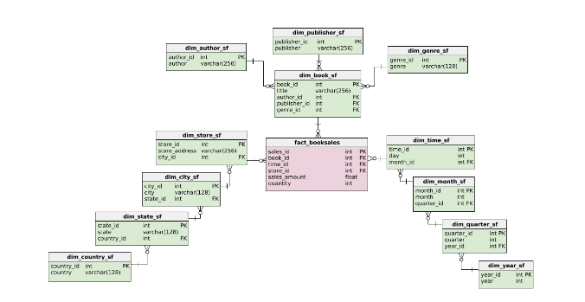

Slide 37
-- Add the book_id foreign key
ALTER TABLE fact_booksales ADD CONSTRAINT sales_book
FOREIGN KEY (book_id) REFERENCES dim_book_star(book_id);
-- Add the time_id foreign key
ALTER TABLE fact_booksales ADD CONSTRAINT sales_time
FOREIGN KEY (time_id) REFERENCES dim_time_star (time_id);
-- Add the store_id foreign key
ALTER TABLE fact_booksales ADD CONSTRAINT sales_store
FOREIGN KEY (store_id) REFERENCES dim_store_star (store_id);

Slide 38
-- Create a new table for dim_author with an author column
CREATE TABLE dim_author (
author varchar(256) NOT NULL
);
-- Insert authors
INSERT INTO dim_author
SELECT DISTINCT author FROM dim_book_star;
-- Add a primary key
ALTER TABLE dim_author ADD COLUMN author_id SERIAL PRIMARY KEY;
-- Output the new table
SELECT * FROM dim_author;

Slide 39


Slide 40
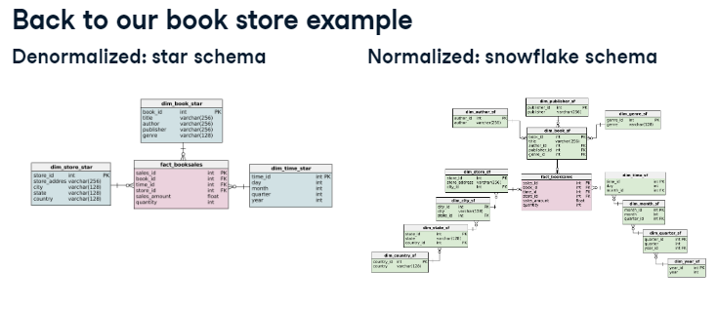

Slide 41
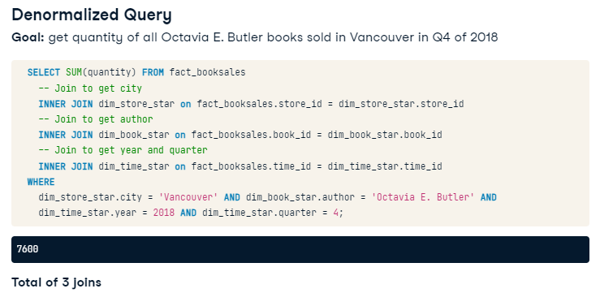

Slide 42
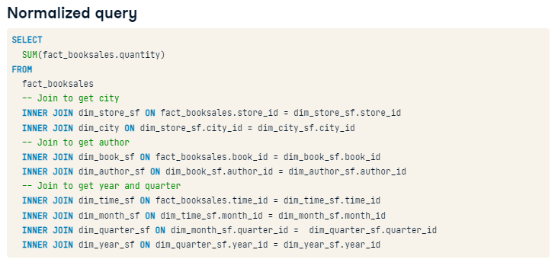

Slide 43
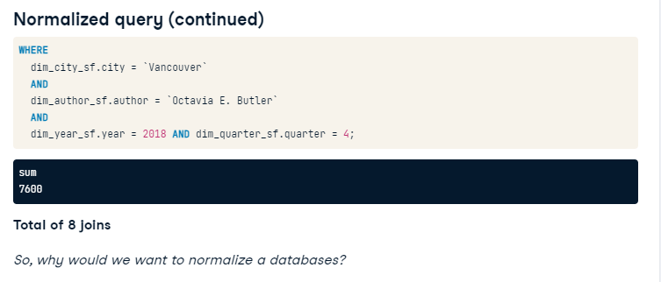

Slide 44
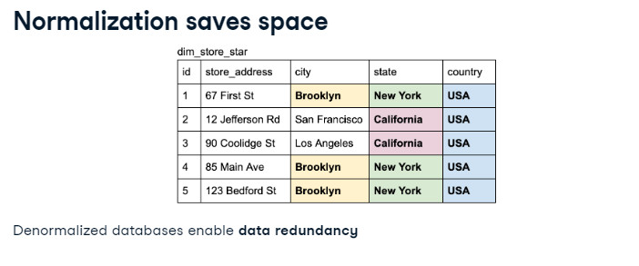

Slide 45
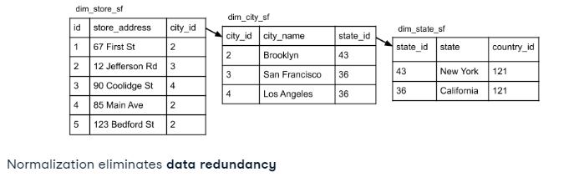

Slide 46
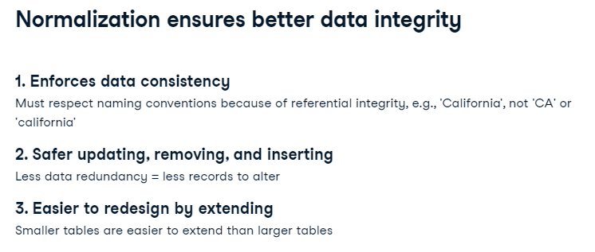
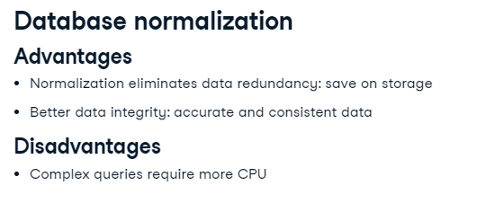

Slide 47
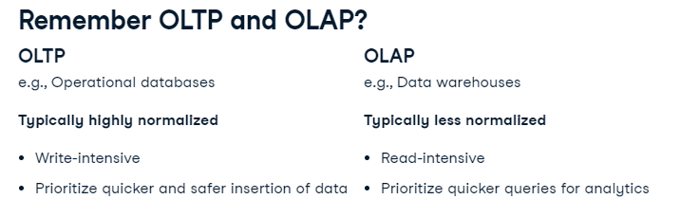

Slide 48
-- Output each state and their total sales_amount
SELECT dim_store_star.state, sum(sales_amount)
FROM fact_booksales
-- Join to get book information
JOIN dim_book_star on fact_booksales.book_id = dim_book_star.book_id
-- Join to get store information
JOIN dim_store_star on fact_booksales.store_id = dim_store_star.store_id
-- Get all books with in the novel genre
WHERE
dim_book_star.genre = 'novel'
-- Group results by state
GROUP BY
dim_store_star.state;

Slide 49
-- Output each state and their total sales_amount
SELECT dim_state_sf.state, SUM(sales_amount)
FROM fact_booksales
-- Joins for genre
JOIN dim_book_sf on fact_booksales.book_id = dim_book_sf.book_id
JOIN dim_genre_sf on dim_book_sf.genre_id = dim_genre_sf.genre_id
-- Joins for state
JOIN dim_store_sf on fact_booksales.store_id = dim_store_sf.store_id
JOIN dim_city_sf on dim_store_sf.city_id = dim_city_sf.city_id
JOIN dim_state_sf on dim_city_sf.state_id = dim_state_sf.state_id
-- Get all books with in the novel genre and group the results by state
WHERE
dim_genre_sf.genre = 'novel'
GROUP BY
dim_state_sf.state;

Slide 50
-- Add a continent_id column with default value of 1
ALTER TABLE dim_country_sf
ADD continent_id int NOT NULL DEFAULT(1);
-- Add the foreign key constraint
ALTER TABLE dim_country_sf ADD CONSTRAINT country_continent
FOREIGN KEY (continent_id) REFERENCES dim_continent_sf(continent_id);
-- Output updated table
SELECT * FROM dim_country_sf;

Slide 51


Slide 52
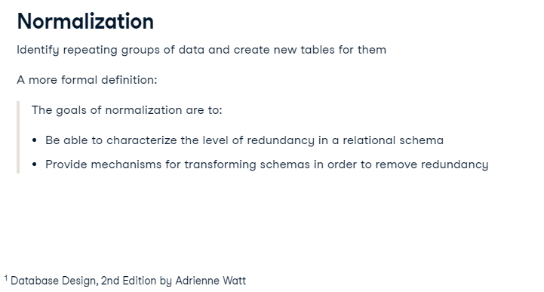

Slide 53
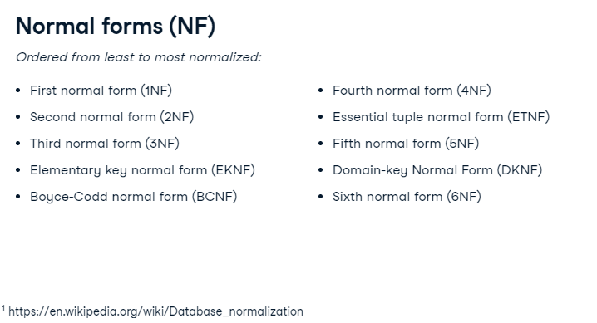

Slide 54
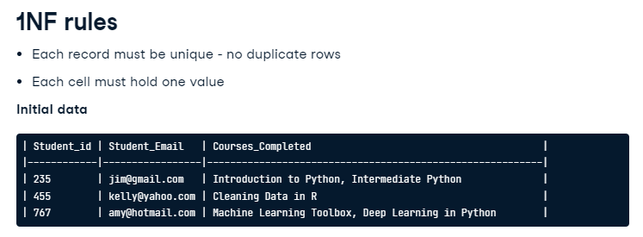

Slide 55
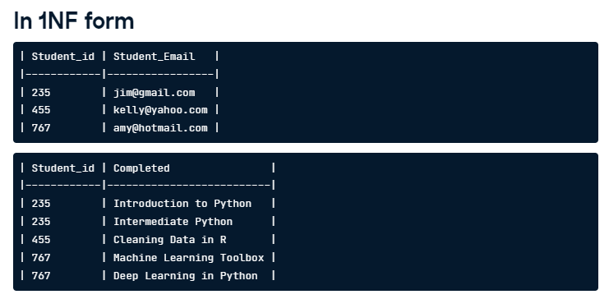

Slide 56
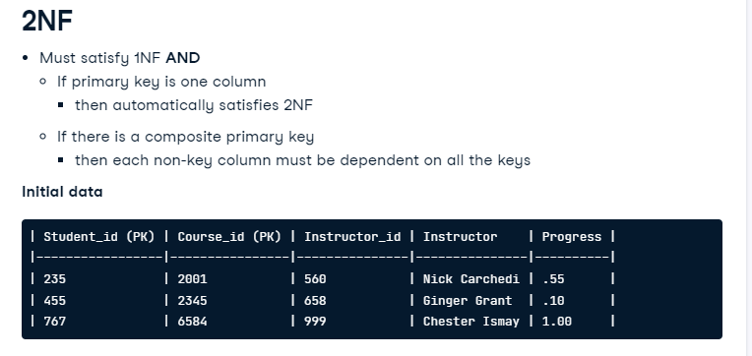

Slide 57
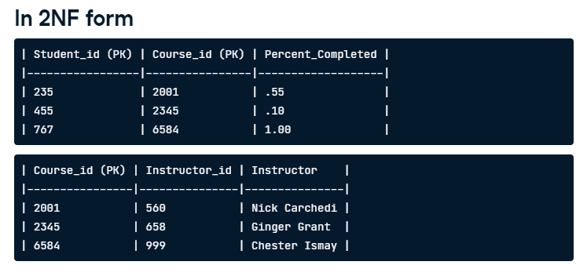

Slide 58
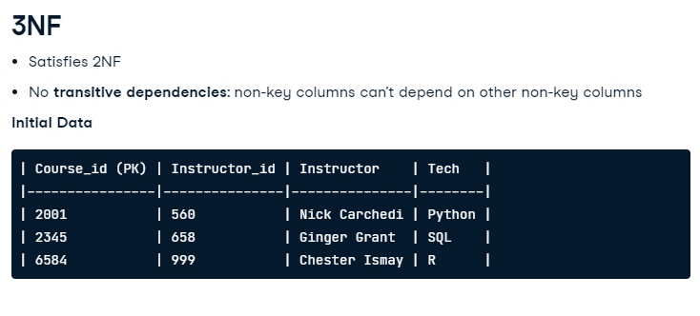

Slide 59
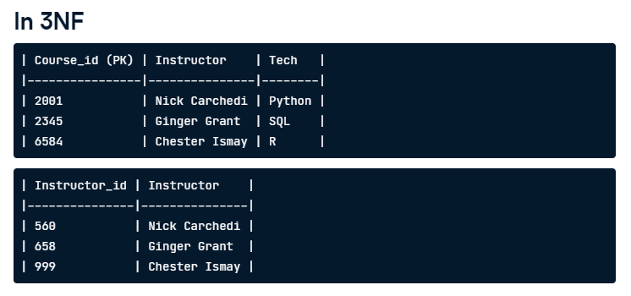

Slide 60
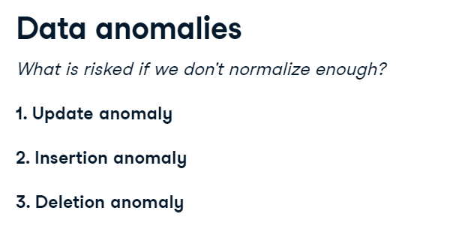

Slide 61
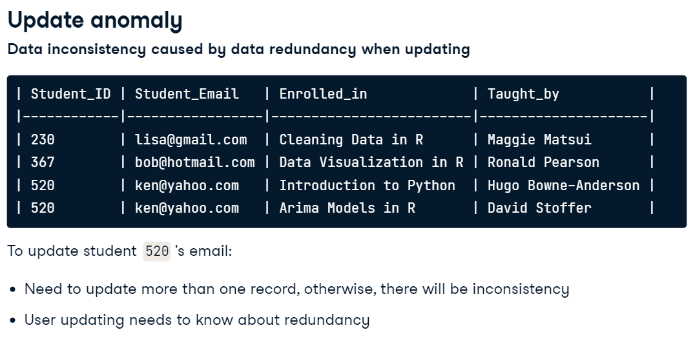

Slide 62


Slide 63


Slide 64


Slide 65
-- Create a new table to hold the cars rented by customers
CREATE TABLE cust_rentals (
customer_id INT NOT NULL,
car_id VARCHAR(128) NULL,
invoice_id VARCHAR(128) NULL
);
-- Drop a column from customers table to satisfy 1NF
ALTER TABLE customers
DROP COLUMN cars_rented,
DROP COLUMN invoice_id;

Slide 66
THANK YOU ☺

